Slide 1
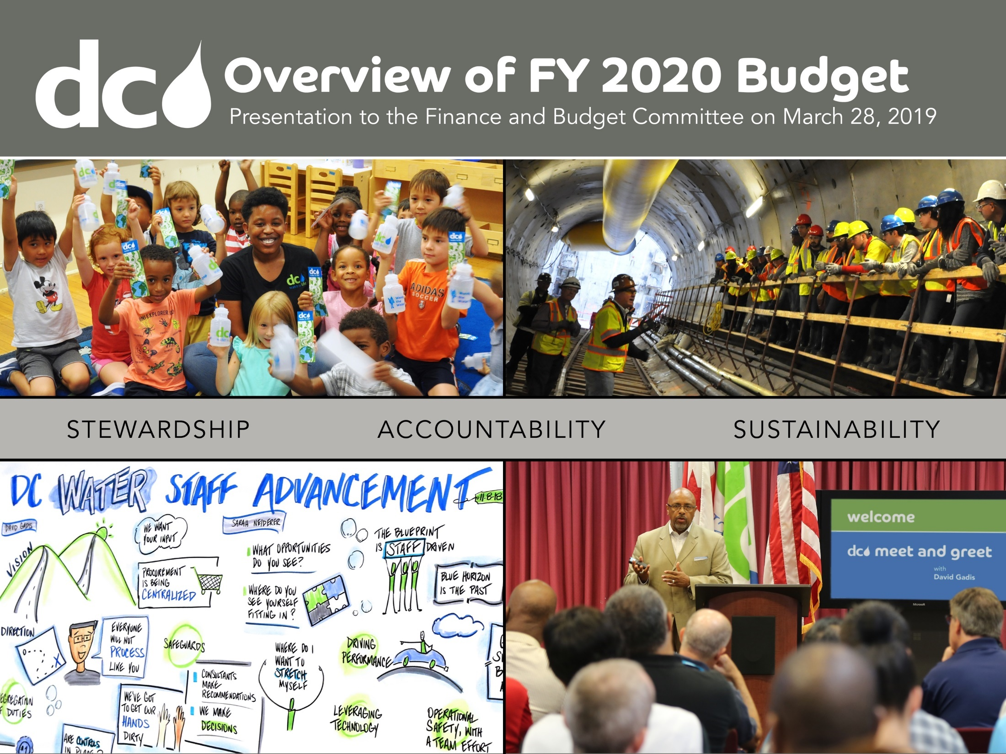
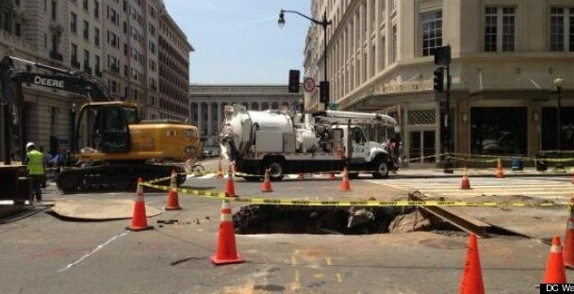
FY 2020 Approved Budget
Approved by the Board of Directors on April 4, 2019

Slide 2
Table of Contents
Executive Summary………………………………….. 3
Capital Improvement Program …….………..……… 7
Operating Expenditure Budget …………….……….. 14
Operating Revenue, Rates & Fees .……..…………… 18

Slide 3
Executive Summary

Slide 4
The FY2020 Budget
Builds on efforts that have taken $27.7 million of cost out of the business including renegotiation of goods and services contracts, reduced hauling and energy costs from the Combined Heat & Power Facilities project, and optimization of usage of chemicals
Eliminates 63 vacancies, a savings of $7 million a year
Shifts a portion of Clean Rivers costs from the Impervious Area Charge to the sewer volumetric rate, bringing more equity to Clean Rivers funding
Increases investment in capital infrastructure including small diameter water mains that deliver water to our customers, and renews aging sewer infrastructure
Helps ensure that all users pay their fair share, by appropriately recovering costs from users though revised engineering fees and the new Fats, Oils, and Grease and Backflow Preventer programs

Slide 5

Tough Choices to Balance the Budget
DC Water made tough budget choices that help ensure that we deliver the best service to our customers
Reduced personnel costs, mainly the elimination of 63 aged vacancies
Reviewed chemical costs, made modest reduction and centralized a contingency
Worked with Washington Aqueduct to reduce their request
Across the board review of contractual costs
Aligned budget with spending for core business functions (reduced reliance on professional consultants for IT, finance & other contracts)
Took costs out of the business by leveraging technology to achieve process efficiencies

Slide 6
Approved FY 2020 Budget
The Operating Budget funds ongoing needs
  It’s $614.5 million, an increase of $31.7 million over the FY 2019 approved budget
  Operations & Maintenance (O&M) - $348.6 million, an increase of $13.5 million mainly in personnel, chemicals and water purchases
  Non O&M - $265.9 million, an increase of $16.3 million for debt service, $1.6 million for Cash Financed Capital Improvements, and $0.3 million for PILOT consistent with District agreement (total of $22 million to the District)
The Capital Budget funds infrastructure investments
  10-year disbursements of $4.96 billion, an increase of $0.95 billion over previous plan
  Spending levels for FY 2019 and FY 2020 remain the same as previous approval
  Capital Projects - Beginning in FY 2021, additional $745.4 million for the increased funding requirements primarily for water and sewer infrastructure
  Capital Equipment - Increase of $142.2 million mainly to fully account for planned spending
  Washington Aqueduct (WAD) - Increase of $67.1 million for DC Water’s share of WAD’s capital program

Slide 7
Capital Improvement Program
(CIP)

Slide 8
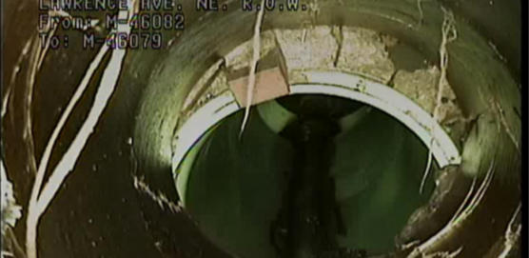
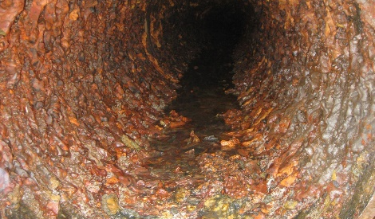
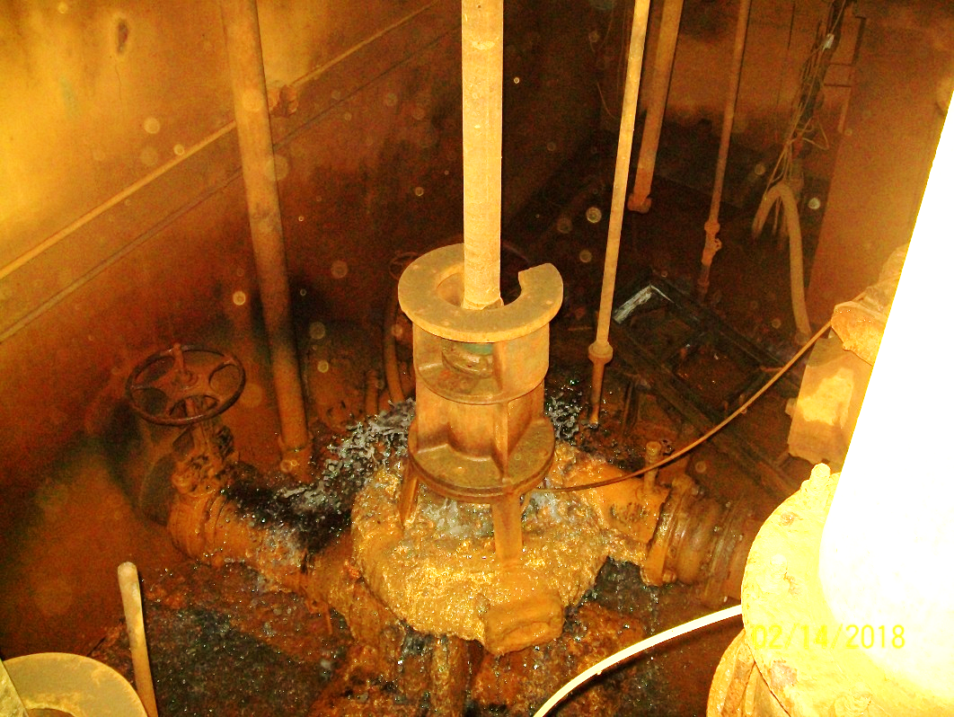
Capital Infrastructure
DC Water, like with many utilities around the nation, faces the challenge of making improvements to its ageing infrastructure
This budget increases the 10-year capital plan to $5 billion in order to fund:
  Rehabilitation of District stormwater pumping stations that clear water from low-lying roads
  Increases investment in sewer infrastructure to help reduce the risk of failure (The average age is currently over 90 years vs expected service life of 110 to 120 years)
  Adds additional funds from water infrastructure renewal (The average age is currently over 80 years vs expected service life of 100 to 120 years)

Slide 9
Capital Investments Review
The Board of Directors had a year-long discussion about our infrastructure, visiting water, sewer and stormwater pump stations, touring the Blue Plains Wastewater Facility, and reviewing the related customer impacts of increased investments needed to fully meet asset management principles for the capital program
  Much of our capital program is largely driven by mandates
  DC Water wants to invest in our linear water and sewer systems to reduce water main breaks and sewer failures
  Major upgrades are needed for the vertical assets in our pumping and treatment facilities, with some of our critical wastewater facilities approaching the end of service life
  Pumps, valves, piping, ventilation and other equipment replacements and major upgrades needed in the 16 stormwater pump stations
The Board examined multiple scenarios and adopted a plan that best balances infrastructure investment with ratepayer affordability

Slide 10
New Capital Investments
The Board adopted a ten year plan that increases capital spending by $0.95 billion
  Budget fully invests in critical infrastructure needs at the Washington Aqueduct that produces water for our customers
  Invests in water and sewer infrastructure that will help reduce the risk of sewer failures, additional water quality complaints, and service disruptions
  Funds major upgrades and rehabilitation of various facilities at our Wastewater Treatment Plant, including the Final Dewatering Facility, Centrifuge Pre-Dewatering, Combined Heat & Power and Digesters for permit compliance
  Adds funding for projects identified for the Potomac Interceptor and Sewer Creekbed to reduce failures
  Funds various upgrades, including Floodproofing, Generators, and other rehabilitation projects needed to improve the condition and drainages of the stormwater pump stations
  Pays for HVAC & Roofing replacements, Main & O Seawall and other historic restoration work needed

Slide 11
Ten Year CIP: Sources of Funds
($000’s)
  Approximately 64% of the capital program is financed with debt and pay-go
Pay-go Financing is any funds available after funding the greater of 120 days or $125.5 million operating and maintenance reserve, approximately $140.0 million in FY 2019. These transfers reduce the amount of new debt issuance
Debt financing refers to the borrowing of funds through long-term revenue bonds, commercial paper/Extendable Municipal Commercial Paper (EMCP) and other short-term notes

Slide 12
10-Year CIP: Disbursements & Lifetime
The Board-approved ten-year capital disbursement of $4.96 billion reflects the increased investments in the ageing water & sewer system and the stormwater pump stations, beginning in FY 2021
The lifetime budget of $12.1 billion is for active projects prior to, during, and beyond the ten-year window
Notes:
I:\DETS\CIP-Capital\Bud19-20\FY19-07 Presentations\020719 BOD Budget Workshop presentation
Source file: FY2019-28 CIP Run5c - Projects 010219 _ Graphs for Feb2019 BoardMeeting.xlsx

Slide 13
Overview of Additional Capital Programs
  Capital Equipment
    $142.2 million increase over the ten-year period is to right-size the latter years for projected needs
  Washington Aqueduct
    $67.1 million increase is for DC Water’s proportionate share of WAD’s infrastructure improvements to achieve established service levels. These excludes the Federally Owned Water Mains, Travillah Quarry Acquisition Outfitting and Advanced Treatment projects
Cash Disbursements, in $000’s

Slide 14
Operating Expenditure

Slide 15
FY 2019 vs. FY 2020 Expenditure Budgets
$ in thousands
Debt service is the major component of the operating budget, at 35% in FY 2020
Approved FY 2019
$582,781
Approved FY 2020
$614,523

Slide 16
Comparative Operating Budgets
Net operating expenditure increase of about 4.8%, mainly in personnel services, water purchases and debt service

Slide 17
Debt Service
  Debt service is one of the fasting growing components of the budget
  It represents 30% and 31% of the total operating budget in FY 2019 and FY 2020, respectively
$ in thousands
* Non-Debt Service includes O&M, PILOT, ROW and CFCI estimates

Slide 18
Operating Revenue, Rates & Fees

Slide 19
Proposed Rates and Fee Changes
The rate proposal incorporates feedback from our stakeholders and various customers
  The budget shifts a portion of the Clean Rivers Impervious Area Charge (CRIAC) to the Sewer Volumetric Rate provides customers the ability to reduce their bills
    Starting with 18% in FY 2020, 28% in FY 2021, and 37% in FY 2022 and beyond
    Based on methodology that allocates volume of Sanitary Wastewater, Stormwater runoff and CSO
    Decreases the Clean Rivers Impervious Area Charge (CRIAC) from projected $25.58 in FY 2020 to $20.94 per ERU, per month and increases the Water & Sewer rate by 11.5% in FY 2020
Starting FY 2021 and beyond, the projected rates support year-long review discussions and commitment by the Board to increase capital investments by $0.95 billion, thereby addressing infrastructural challenges
Increase from 4% to 20% CRIAC discount for Stormwater Best Management Practices
Overall household charges increase of 5.7% is the same as previously forecasted for FY 2020 (Average household charge changes from $114.48 to $114.49)

Slide 20
FY 2019 vs. FY 2020 Operating Revenues
DC Water has a diversified customer base and stable revenue structure which is necessary to recoup the cost of services
Revised FY 2019
$665,650
Approved FY 2020
$693,979
($000’s)

Slide 21
Revenue Comparison by Customer Class
Total revenue is projected to increase by $28.3 million or 4.3%
Retail revenue is projected to increase by $27.9 million or 5.4%
Wholesale revenue is projected to decrease by $0.5 million or 0.5% because of flows
($000's) | Revised | Approved | Incr/(Decr)
 | FY 2019 | FY 2020 | $ | %
Retail Revenue | $521,626 | $549,553 | $27,927 | 5.4%
Wholesale Revenue
Potomac Interceptor (PI) | 2,715 | 2,715 | - | -
Loudoun County Sanitation Authority (LCSA) | 7,541 | 7,758 | 217 | 2.9%
Washington Suburban Sanitary Commission (WSSC) | 58,335 | 57,284 | (1,051) | (1.8%)
Fairfax County | 14,401 | 14,782 | 381 | 2.6%
Total Wholesale Revenue | $82,992 | $82,539 | ($453) | (0.5%)
Other Revenue | 61,032 | 61,887 | 855 | 1.4%
Total Revenues | $665,650 | $693,979 | $28,329 | 4.3%
DC Water’s revenue comes from rates paid by our retail and jurisdictional customers for their proportionate share of the cost of operations

Slide 22
Historic and Projected Combined Household Increases for Residential Customers
The projected increases for the average residential household supports the additional capital investments, starting FY 2021 to address the infrastructural challenges

Slide 23
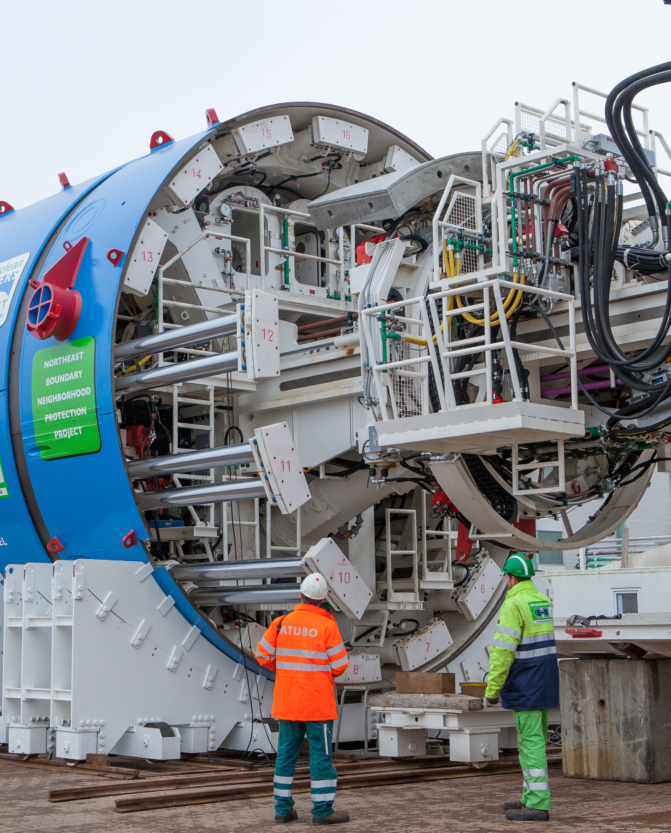
Impact of the CRIAC Shift
This year’s budget proposal includes a phase-in approach to shift some of the CRIAC costs to Sewer Volumetric Rates
  18% in FY 2020, 28% in FY 2021 and 37% in FY 2022 and beyond
Shifting some of the Clean Rivers cost recovery to the volumetric rate gives customers more control over the amount that they pay towards the project
As a class, the Multi-family and Commercial who use more water would pay more, while Federal Government would pay less
Small volume customers in every class would generally pay less
Average Residential customers would pay about the same

Slide 24
Projected Clean Rivers Impervious Area Charge
Charges are driven by debt service costs necessary to support the $2.7 billion Clean Rivers Project
CRIAC charges reflect shift of project costs to Sewer Volumetric, with 18% in FY 2020, 28% in FY 2021 and 37% in FY 2022 and beyond
The annual Clean Rivers Project costs for the average residential customer (700 – 2,000 sq. ft. of impervious area) is projected to increase from $251.28 in FY 2020 to $351.72 in FY 2028

Slide 25
Sample of DC Water’s Customers and Projected Monthly Bills
Residential – Avg. 6.2 Ccf / 1ERU Baseline $5.0B Phase-In18%-28%-37% | 2019 | 2020 | 2021 | 2022 | 2023 | 2024 | 2025 | 2026 | 2027 | 2028
Water & Sewer Rate (%) | 13.0% | 11.5% | 12.5% | 11.5% | 8.5% | 7.5% | 6.0% | 5.5% | 5.5% | 4.5%
CRIAC ($/ERU) | $23.00 | $20.94 | $20.95 | $19.85 | $21.45 | $25.28 | $24.35 | $25.06 | $25.73 | $29.31
Avg. Customer Bill ($) | $108 | $114 | $124 | $133 | $143 | $155 | $161 | $168 | $176 | $185
Avg. Customer Bill (%) | 5.9% | 5.7% | 8.5% | 7.3% | 7.4% | 8.2% | 3.8% | 4.5% | 4.5% | 5.5%
Multi-family – Avg. 92.6 Ccf / 6.3 ERU Baseline $5.0B Phase-In 18%-28-%37% | 2019 | 2020 | 2021 | 2022 | 2023 | 2024 | 2025 | 2026 | 2027 | 2028
Water & Sewer Rate (%) | 13.0% | 11.5% | 12.5% | 11.5% | 8.5% | 7.5% | 6.0% | 5.5% | 5.5% | 4.5%
CRIAC ($/ERU) | $23.00 | $20.94 | $20.95 | $19.85 | $21.45 | $25.28 | $24.35 | $25.06 | $25.73 | $29.31
Avg. Customer Bill ($) | $1,303 | $1,413 | $1,558 | $1,704 | $1,837 | $1,981 | $2,077 | $2,180 | $2,289 | $2,403
Avg. Customer Bill (%) | 9.2% | 8.5% | 10.3% | 9.4% | 7.8% | 7.8% | 4.8% | 5.0% | 5.0% | 4.9%
Commercial – Avg. 114 Ccf / 13.1 ERU Baseline $5.0B Phase-In18%-28%-37% | 2019 | 2020 | 2021 | 2022 | 2023 | 2024 | 2025 | 2026 | 2027 | 2028
Water & Sewer Rate (%) | 13.0% | 11.5% | 12.5% | 11.5% | 8.5% | 7.5% | 6.0% | 5.5% | 5.5% | 4.5%
CRIAC ($/ERU) | $23.00 | $20.94 | $20.95 | $19.85 | $21.45 | $25.28 | $24.35 | $25.06 | $25.73 | $29.31
Avg. Customer Bill ($) | $1,850 | $1,978 | $2,164 | $2,345 | $2,527 | $2,732 | $2,852 | $2,990 | $3,134 | $3,299
Avg. Customer Bill (%) | 7.7% | 6.9% | 9.4% | 8.3% | 7.7% | 8.1% | 4.4% | 4.8% | 4.8% | 5.2%

Slide 26
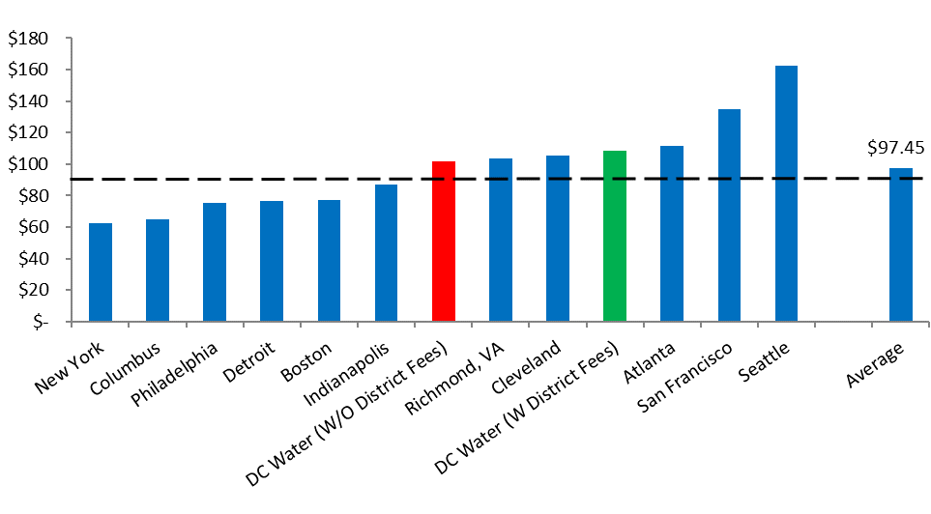
DC Water Compared to CSO Communities
DC Water is implementing an expensive consent decree program, $2.7 billion paid for by 700,000 residents (or 125,000 customer accounts)
Some other communities have lower consent decree programs and larger population sizes
* Assumes average residential consumption of 6.20 Ccf, or 4,638 gallons, per month. Ccf = hundred cubic feet, or 748 gallons
Reflects rates and fees in place as of November 1, 2018

Slide 27
Customer Assistance Program (CAP)
Eligible customers for CAP, as administered by DOEE, would receive a discount of 58.8% in FY 2020

Slide 28
SFR Monthly Bills – Comparison of Charges With & With Out Income-Based Affordability Programs

Slide 29
Projected Average Residential Customer Bill
Projected average monthly residential customer bill ranges from $108 in FY 2019 to $185 in FY 2028

Slide 30
CRIAC Discount
Increased CRIAC Discount to Customers
Resolution #13-80 – DC Water established the Clean Rivers Impervious Surface Area Charge (CRIAC) Incentive Discount Program
  4% maximum incentive credit
  Concern about ensuring that DC Water has sufficient resources to pay mandated Clean Rivers costs
The Incentive Program
  Customers who manage stormwater on their property through the use of approved best management practices such as rain gardens, rain barrels, pervious paving, green roofs, bioretention practices, and stormwater
  Eligibility determinations are made by the District Department of Energy and the Environment (DOEE)
This budget proposal increases the discount from 4% to 20% for stormwater best management practices

Slide 31
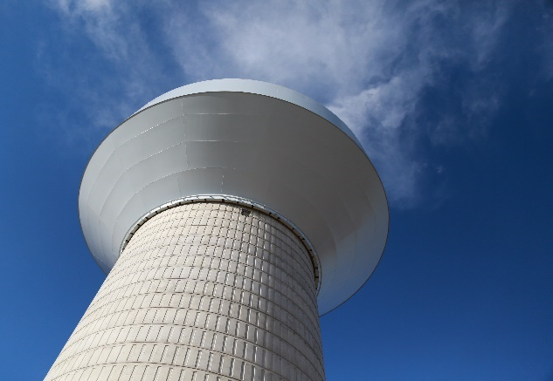
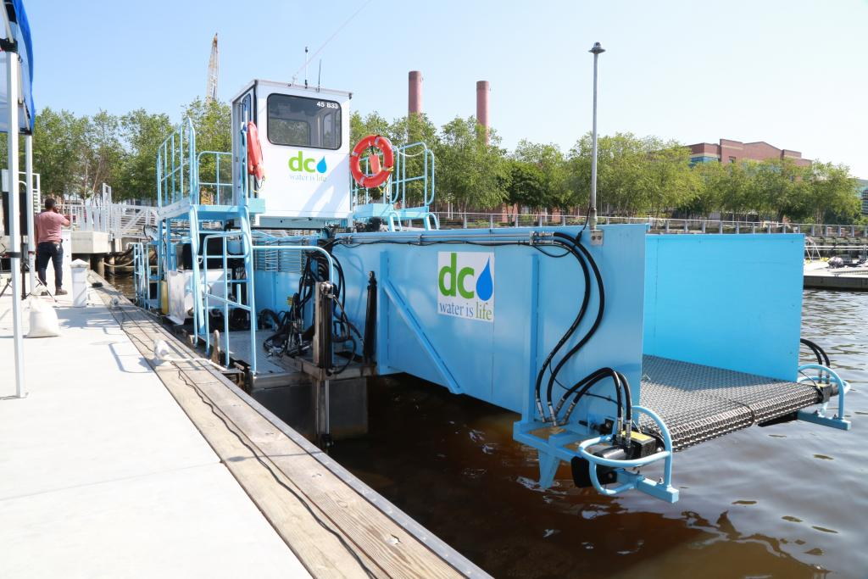
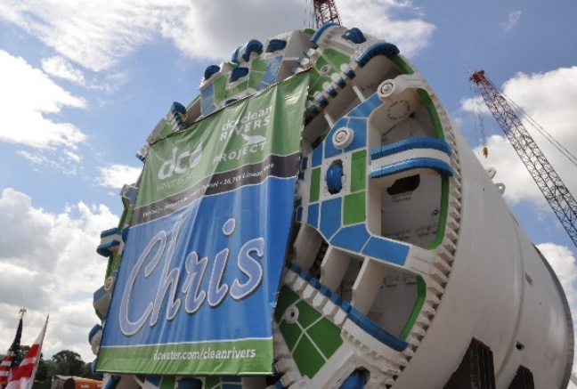
DC Water’s Promise to Our Customers
DC Water is committed to providing superior service, ingenuity and stewardship to our customers
We are efficient with our rate payers money
We are devoted to improving water quality
We provide work to small and minority businesses
We continue to explore and invest in initiatives with great environmental benefits (Clean Rivers, Solar Project)
We are a great place to work
Saint Elizabeth Water Tower
Boat Skimmers to Clean the Anacostia River
Anacostia River Tunnel

