Slide 1
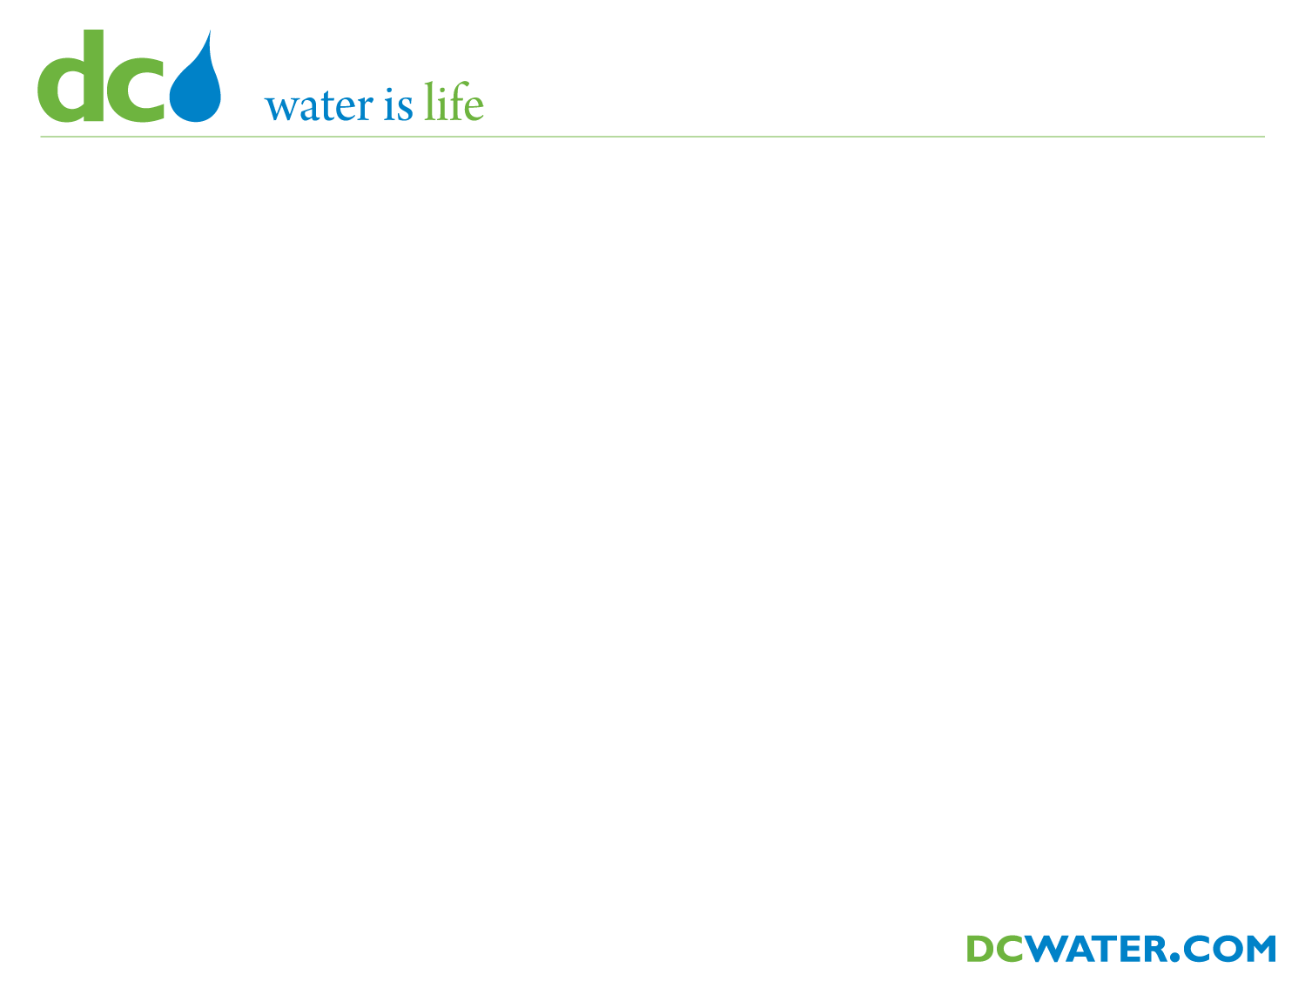

District of Columbia Water and Sewer Authority
George S. Hawkins, General Manager
Briefing on:
DC CLEAN RIVERS PROJECT
Anacostia River Projects
Divisions J and M
(Northeast Boundary Tunnel Alignment)
Briefing for:
ANC 5B Monthly Meeting
October 6, 2011

Slide 2
Agenda
What is a CSO?
Overview of CSO Program
DC Clean Rivers Project Snapshot
Divisions J & M

Slide 3
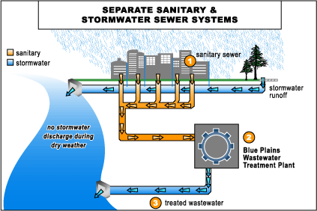
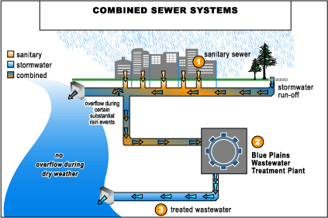
What is a CSO?
100% of Suburbs
67% of DC
0% of suburbs
33% of DC

Slide 4
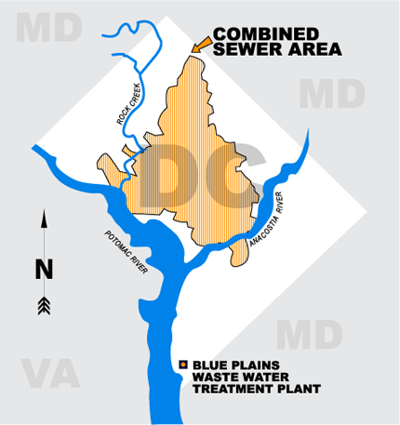
Combined Sewer Area
1/3 area is combined (12,478 acres)
53 CSO outfalls
  15 to Anacostia
  10 to Potomac
  28 to Rock Creek
Three receiving waters
  Anacostia River
  Potomac River
  Rock Creek

Slide 5
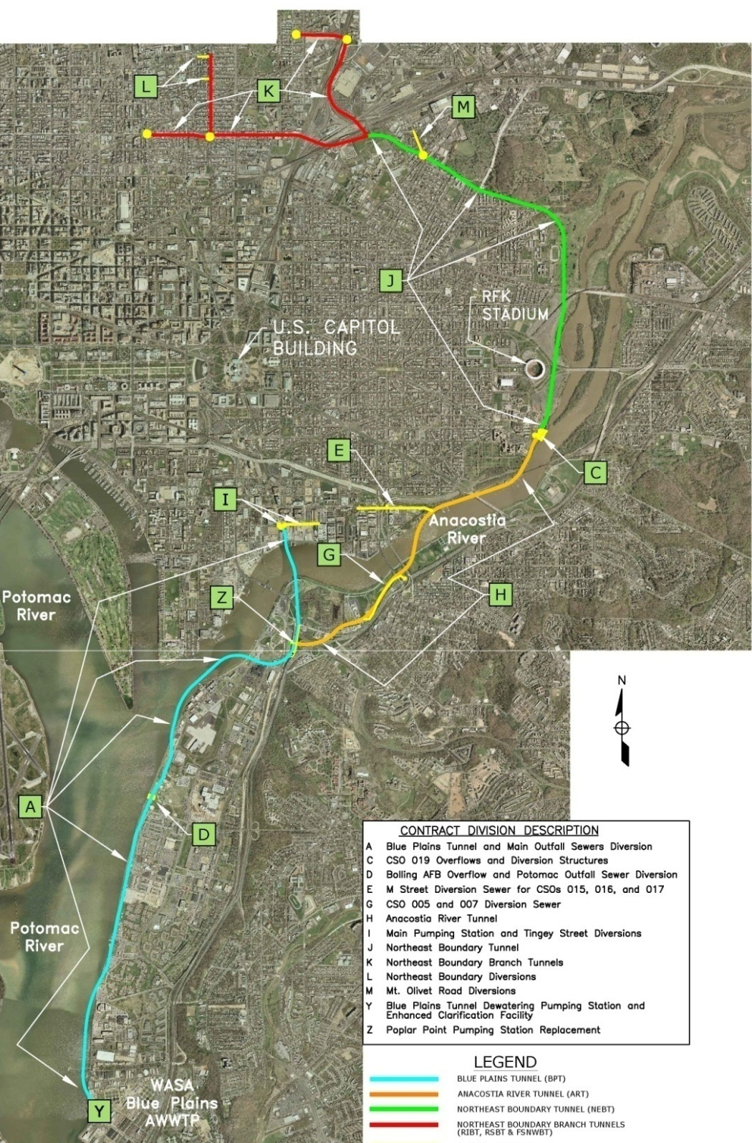
Project Snapshot
Long Term Control Plan (LTCP)
  Control combined sewer overflows (CSOs)
  Reduce flooding
  Meet nutrient discharge limits of Chesapeake Bay Program
Schedule
  LTCP = 20 years (2005-2025)
  Nitrogen = 2007-2015
Cost
  LTCP = $2.5 billion
  Nitrogen = $950 M
  Total > $3.5 billion
Drivers
  Projects required to meet regulatory requirements (NPDES Permit and Consent Decrees)
A Blue Plains Tunnel
C CSO 019 Overflow and Diversion Structures
D JBAB Overflow and Potomac Outfall Sewer Diversion
E M Street Diversion Sewer (CSOs 015, 016 and 017)
G CSO 007 Diversion Structure and Diversion Sewer
H Anacostia River Tunnel
I Main Pumping Station and Tingey Street Diversions
J Northeast Boundary Tunnel
K Northeast Boundary Branch Tunnels
L Northeast Boundary Diversions
M Mt. Olivet Road Diversions
Y Blue Plains Dewatering Pumping Station and ECF
Z Poplar Point Pumping Station Replacement

Slide 6
Geotechnical Investigation
Northeast Boundary Tunnel Alignment
SCOPE OF WORK
In preparation for construction under the NEBT alignment, the following work items are included:
Drilling and sampling of approximately 29 borings along the tunnel alignment
Field Testing/sampling
Installation of groundwater monitoring and sampling wells
Land surveys to record locations of borings and wells for future reference

Slide 7
Geotechnical Investigation
Northeast Boundary Tunnel Alignment
SCHEDULE
Estimated start (for field investigation work): September 2011
Estimated completion: March 2012
Normal work hours: 7:00 a.m. – 6:00 p.m., Monday through Friday

Slide 8
Geotechnical Investigation
Northeast Boundary Tunnel Alignment
IMPORTANT INFORMATION
All work areas will be secured by fencing and shielding.
Soil and groundwater extracted from boring sites will be drummed and transported to approved off-site disposal areas.
Residents and will be notified prior to the start of drilling activities.
Noise levels caused by drilling equipment will be electronically monitored.

Slide 9
Geotechnical Investigation
Northeast Boundary Tunnel Alignment
IMPORTANT INFORMATION
Some vibrations may be felt during subsurface soil sampling.
DC Water will work to ensure minimal disruption to residents during the drilling operations.

Slide 10
Geotechnical Investigation
Northeast Boundary Tunnel Alignment
TRAFFIC PLANS
Traffic Control Plans for each investigation site along the NEBT will be approved by the District Department of Transportation (DDOT).
Some temporary lane shifts on Kendall Street NE, Capitol Avenue NE and Mt. Olivet Road NE may occur during the investigations.

Slide 11
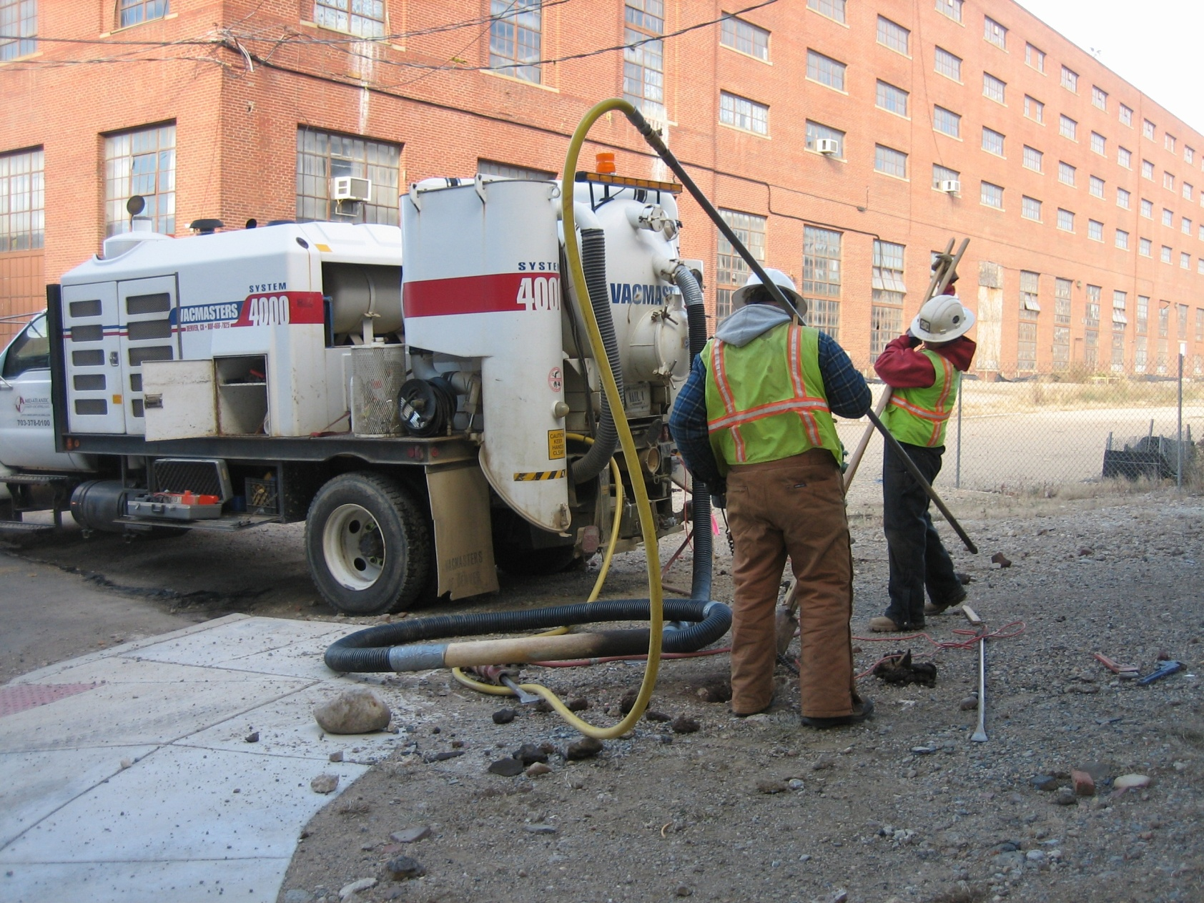
Field Equipment – Soft Dig

Slide 12
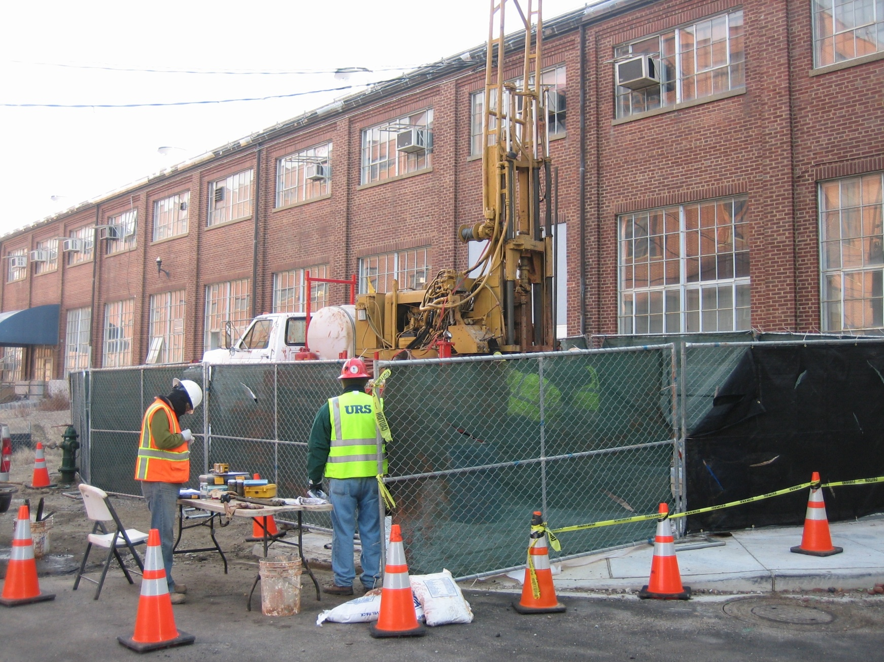
Field Equipment – Work Area

Slide 13
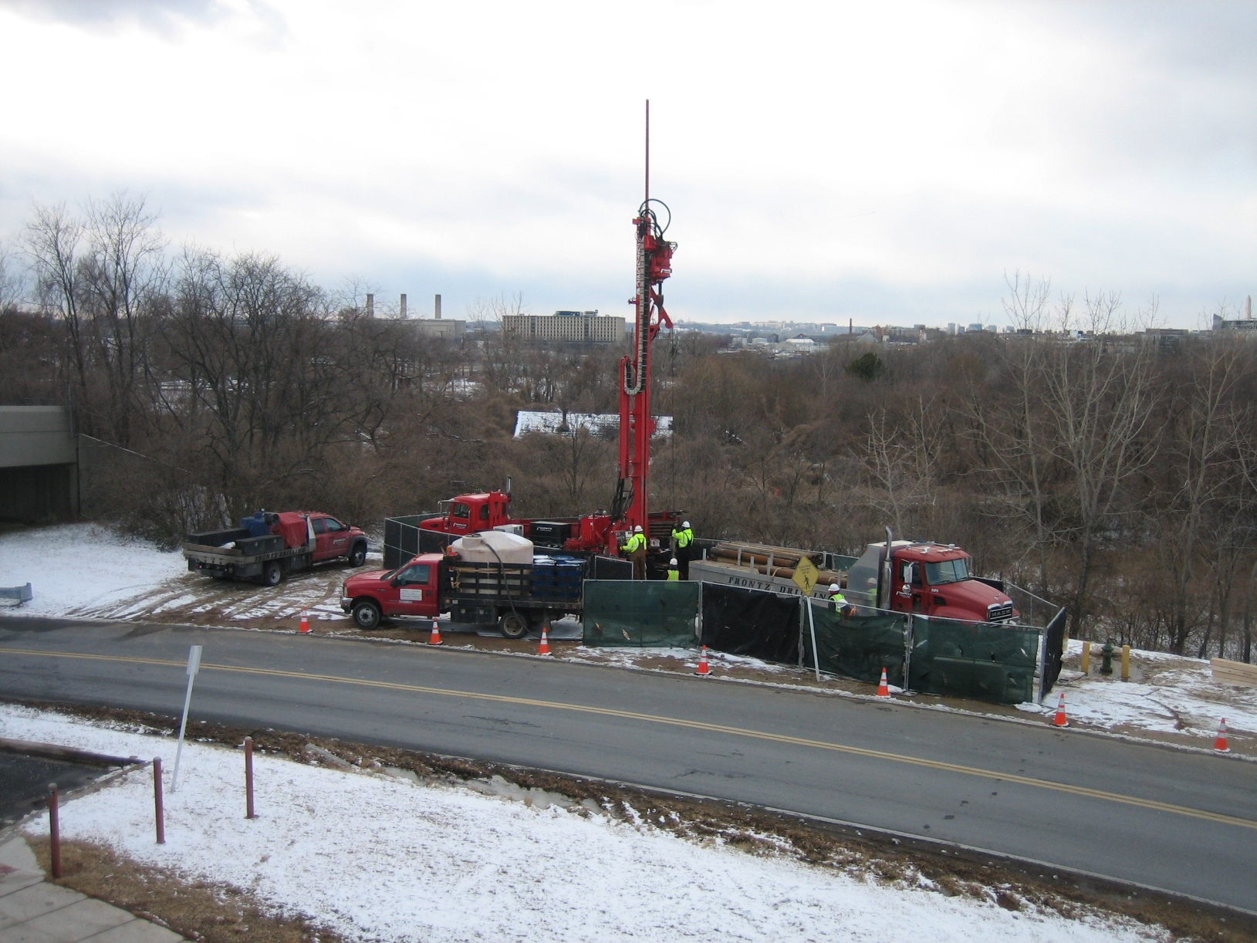
Field Equipment - Sonic

Slide 14
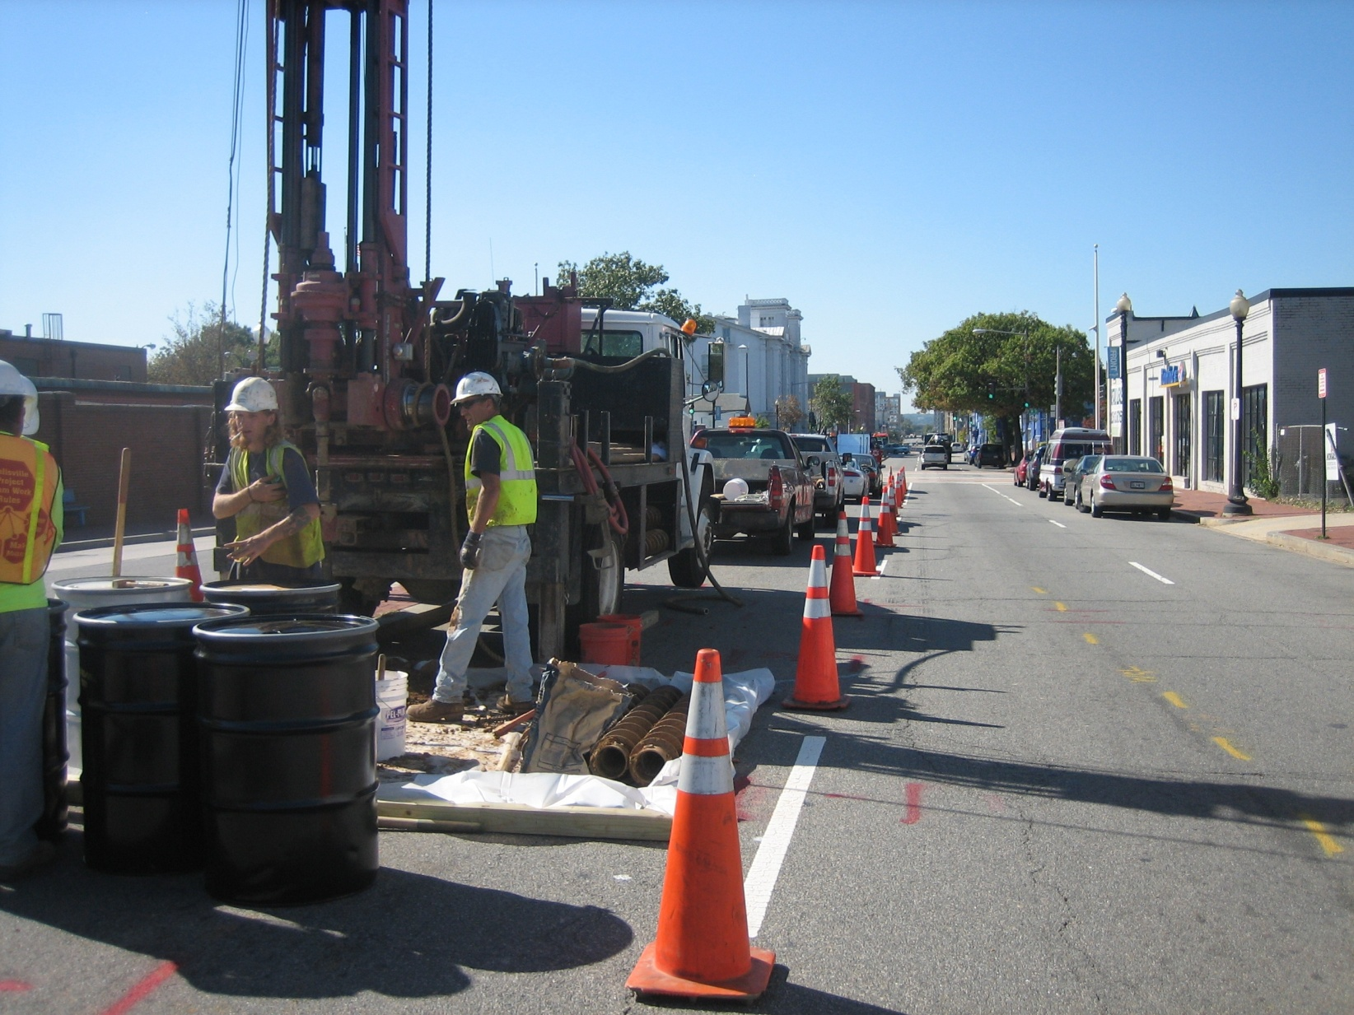
Field Equipment – Hollow Stem

Slide 15
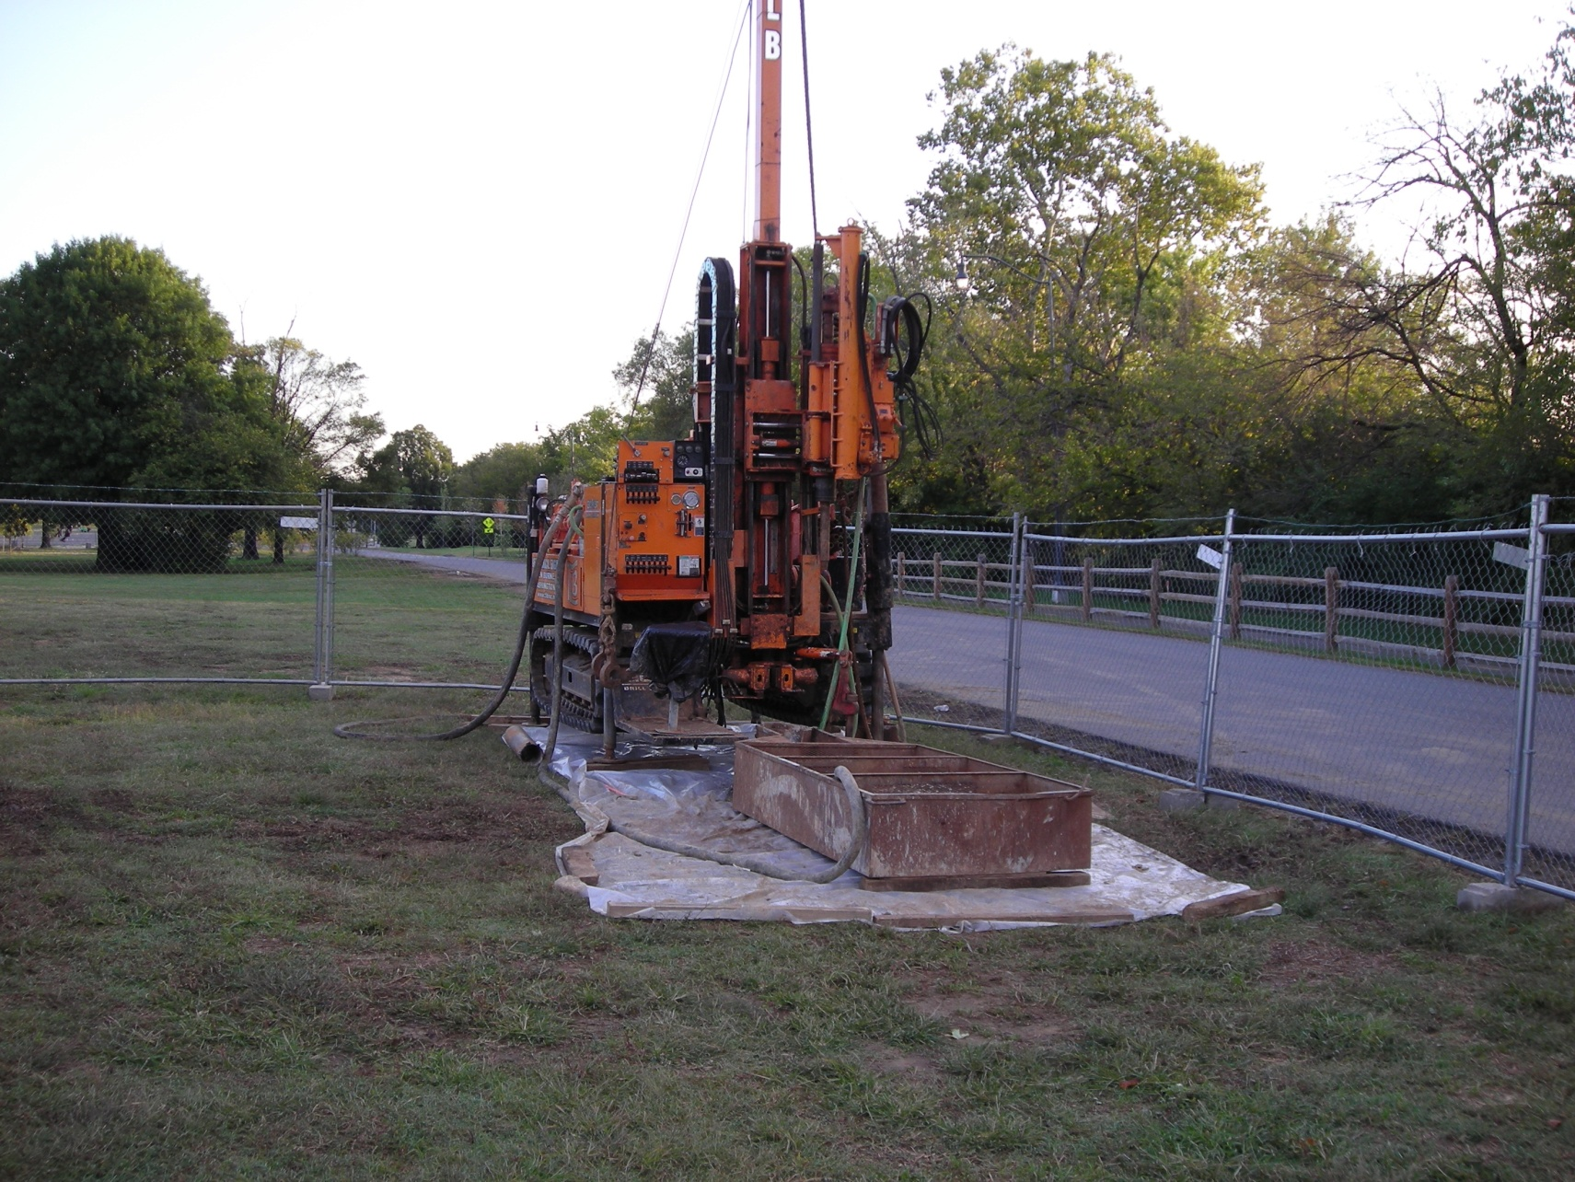
Field Equipment – Mud Rotary

Slide 16
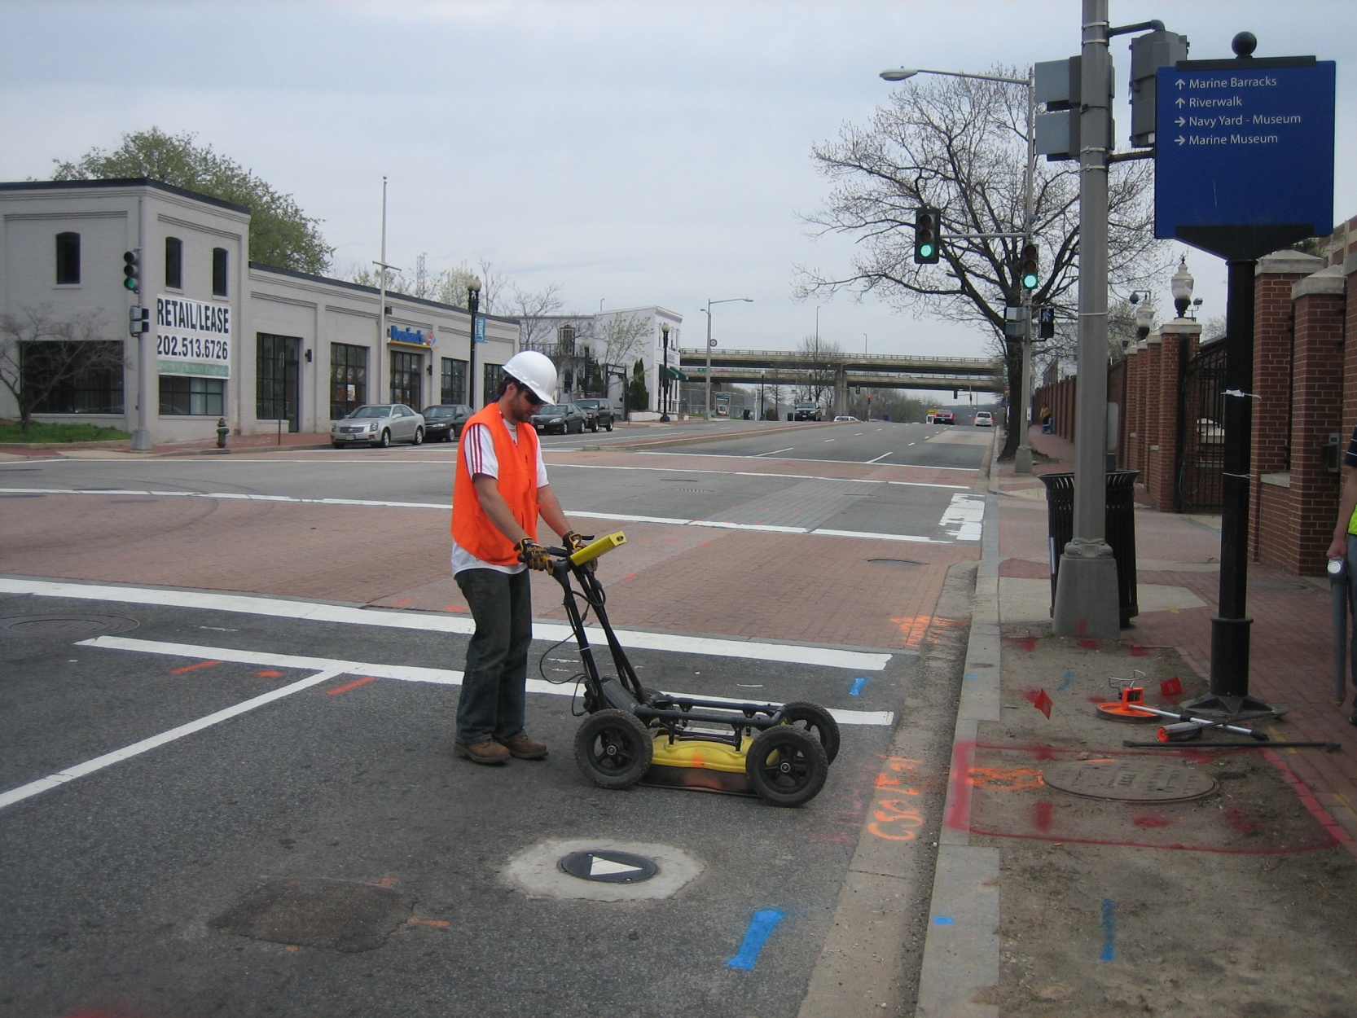
Geophysical Survey
- Ground Penetrating Radar

Slide 17
Geology Interpretations

Slide 18
Next Steps
Contract Award for Field Investigative Work
DDOT/NPS Permit Applications
Public Outreach Program
Field Work – September 2011 – March 2012

